Slide 1
Chapter 5
Hardware Trojan

Slide 2
Threats
SoC Life-Cycle
Threats
Solutions
IP Vendor
Insert h/w Trojan; hidden backdoor
Trojan-res. design; improve. detectability; trust validation
Spans all stages in IC life cycle
IP piracy (cloning)
SoC Design House
Trojan in design (e.g. by tools)
Hardware Obfuscation; Protect IP Eval. Copy, PUF, Low-cost authentication
Foundry
Implant Trojan
Overproduction & cloning
SCA resistant Design; Prevent scan-based attack; variable ECC
Deployment
Leak secret info.
Magnetic field atk.

Slide 3
What is Hardware Trojan?
Hardware Trojan:
A malicious addition or modification to the existing circuit elements.
What hardware Trojans can do?
Change the functionality
Reduce the reliability
Leak valuable information
Applications that are likely to be targets for attackers
Military applications
Aerospace applications
Civilian security-critical applications
Financial applications
Transportation security
IoT devices
Commercial devices
More
Notes:
Everyone may be familiar with software Trojan. The definition of hardware Trojan is malicious additions or modification to the original design.
Comparing to software Trojan, hardware Trojan is more difficult to detect and kill them. Once the chip is fabricated, we cannot make any change anymore.
Therefore, hardware Trojan is potential threat to the security of our systems.
Hardware Torjan can change the functionality and create failure. It can reduce the reliability as well. It also can leak secret informatino and transmit to adversaries.
All the secure-critical applications are potential targets for attackers, such as military, financial and transportation applications.

Slide 4
IC/IP Trust Problem
Chip design and fabrication has become increasingly vulnerable to malicious activities and alterations with globalization.
IP Vendor and System Integrator:
IP vendor may place a Trojan in the IP
IP Trust problem
Designer and Foundry:
Foundry may place a Trojan in the layout design.
IC Trust problem
Notes:
As the process of integrated circuits (ICs) shrinks to submicron level, the complexity of and cost of IC fabrication increase significantly. Many IC companies cannot afford to keep upgrading the manufacture process. They just send their design to foundry and let foundry to fabricate and test them. This might be a potential opportunity for attacker to implant Trojans. Additionally, design may use third party IPs. These Trojans may be already inserted in IP cores.

Slide 5
Hardware Trojan Threat
IP Vendor
System Integrator
Manufacture
Any of these steps can be untrusted
5
Notes:
The figure shows the relationship among IP vendor, system integrator and manufacture (foundry).
System integrator integrates IPs from its own or IP vender on a system.
The design is given to foundry to manufacture.
However, any of these steps can be untrusted to cause hardware security issues.

Slide 6
Hardware Trojan Threat
IP Vendor
IP Trust
System Integrator
Manufacture
Untrusted
6
Notes:
If the IP vendor is untrusted, IPs designed by IP vendor may contain Hardware Trojans to threat the system.
This is called “IP trust” issue.

Slide 7
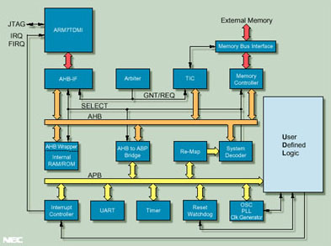
Issues with Third IP Design
Company X
System-on-chip (SoC)
Company Y
Company Z
Company V
Company W
7
Notes:
This is example of SOC design.
Each module is designed independently by different IP vendors. System integrator puts them together on a single chip.

Slide 8
Issues with Third IP Design
Company X
System-on-chip (SoC)
These companies are located across the world
There is no control on the design process
Company Y
Company Z
Company V
Company W
8
Notes:
Since IPs are designed by IP vendors across the world, there is no control on the design process.
Therefore, the entire system is untrusted if any IP is untrusted.

Slide 9
Hardware Trojan Threat
IP Vendor
System Integrator
SoC Trust
Manufacture
Untrusted
9
Notes:
If the system integrator is untrusted, system integrator can steal the design of IP or manufacture more than the number they should manufacture (overproduce). These are IP piracy and system trust issues.
IP watermarking techniques are proposed to deal with these issues.

Slide 10
Hardware Trojan Threat
IP Vendor
System Integrator
Manufacture
Untrusted Foundry
Untrusted
IC Trust
10
Notes:
Since most IC companies become fabless, chips are fabricated and tested at third party foundry. If chips are fabricated in an untrusted foundry, a lot of security issues are involved.
If foundry modifies the original design and inserts a Trojan into it, this is IC trust issue.
If foundry overproduces chips, clone chips and so on, these are counterfeit issues.
In the end, the foundry will test all chips. This is about secure manufacturing test.
In this chapter, we focus on IC trust issue.

Slide 11
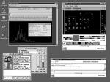

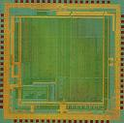
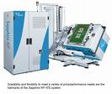


ASIC Design Process – Untrusted Foundry
IP
CAD Tools
STD Cells
Models
Design Specification
Design Process
Design
Fabrication Process
Fab Interface
Mask
Fab
Wafer Probe
Dice & Package
Package Test
Manufacturing
Test Process
Trusted
IC Authentication: Trojan Detection and Isolation
Deploy and Monitor
Either
Untrusted
11
Notes:
This slide show the AISC process in foundry, which includes design process, fabrication process and manufacturing test process.
Untrusted foundry may result in insecure fabrication process, as shown in red rectangles.

Slide 12
Untrusted Designer and Foundry
IP
CAD Tools
STD Cells
Models
Design Specification
Design Process
Design
Fabrication Process
Fab Interface
Mask
Fab
Manufacturing
Test Process
Wafer Probe
Dice & Package
Package Test
Trusted
IC Authentication: Trojan Detection and Isolation
Either
Deploy and Monitor
Untrusted
12
Notes:
This slide show the AISC process in foundry, which includes design process, fabrication process and manufacturing test process.
In this figure, both design process and fabrication process are untrusted.

Slide 13
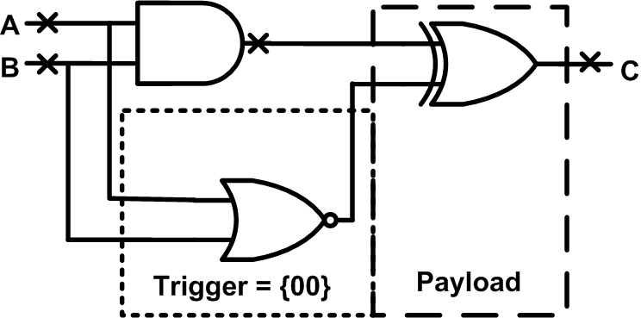
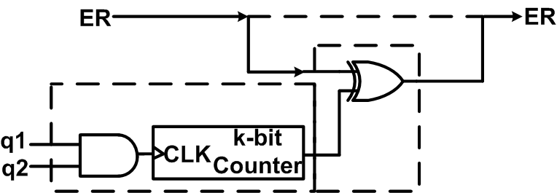
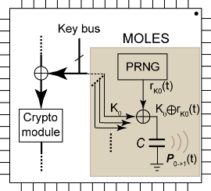
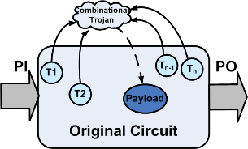
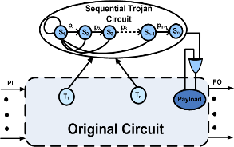
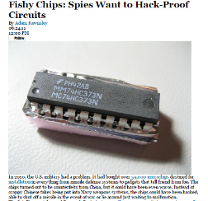
HW Trojan Examples / Models
Comb. Trojan Example
Seq. Trojan Example
MOLES*: Info Leakage Trojan
Comb. Trojan model
Seq. Trojan Model
HW Trojan evidence!
*Lin et al, ICCAD 2009

Slide 14
Why is detection of hardware Trojans very difficult?

Slide 15
Bug vs. Malicious Change
Verification (Traditional)
Bugs (Unintentional)
Bounded by Spec
Trust Verification
Malicious change
(Intentional)
Unwanted functionality
(Unbounded)
Trojan Attacks → BIGGER verification challenge!

Slide 16


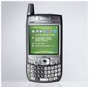

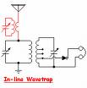


Silicon Back Door
Adversary can send and receive secret information
Adversary can disable the chip, blowup the chip, send wrong processing data, impact circuit information etc.
Antenna
Untrusted Hardware
Adversary can place an Antenna on the fabricated chip
Such Trojan cannot be detected since it does not change the functionality of the circuit.
Notes:
Here is an example of hardware Trojan. An antenna is inserted by attackers on a fabricated chip which might be used in security systems. Such Trojan cannot be detected by functional structural test since it does not change the functionality of the circuit. When this chip is put into a system, it will act like a back door. Attacker can receive secret information from chip inside and send command to control the chip, such as disable chip, blowup chip and so on.

Slide 17
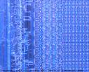


Silicon Time Bomb
Counter
Finite state machine (FSM)
Comparator to monitor key data
Wires/transistors that violate design rules
Untrusted Hardware
Such Trojan cannot be detected since it does not change the functionality of the circuit.
In some cases, adversary has little control on the exact time of Trojan action
Cause reliability issue
17
Notes:
Here is another example of hardware Trojan, a time bomb which will destroy the chip. Trojan has many ways to be triggered. It will be activated when a counter gets to a specified value, FSM goes to a certain state, or a certain key is used. Additionally, attacker can modify the wire/transistor width to make it age faster to cause reliability issues.

Slide 18
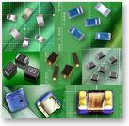
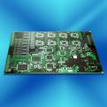
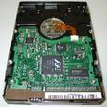

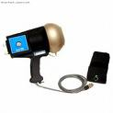






Applications and Threats
Thousands of chips are being fabricated in untrusted foundries
18
Notes:
All there application might be attacked.

Slide 19
Comprehensive Attack Model
19
Notes:
How can we trust an IP? How can one establish that the IP does exactly as the specification, nothing less and nothing more?
IP cores from untrusted vendors need to be verified for trust before they are integrated in a system.
Since IP cores have different formats, different methods should be used.
Here are challenges to detect Trojans in IP cores.
There is no golden model for IP core. We have to check its functionality.
We do not know how the layout looks like, if only the HDL is available.
Side-channel signal methods are not working for soft IP.

Slide 20

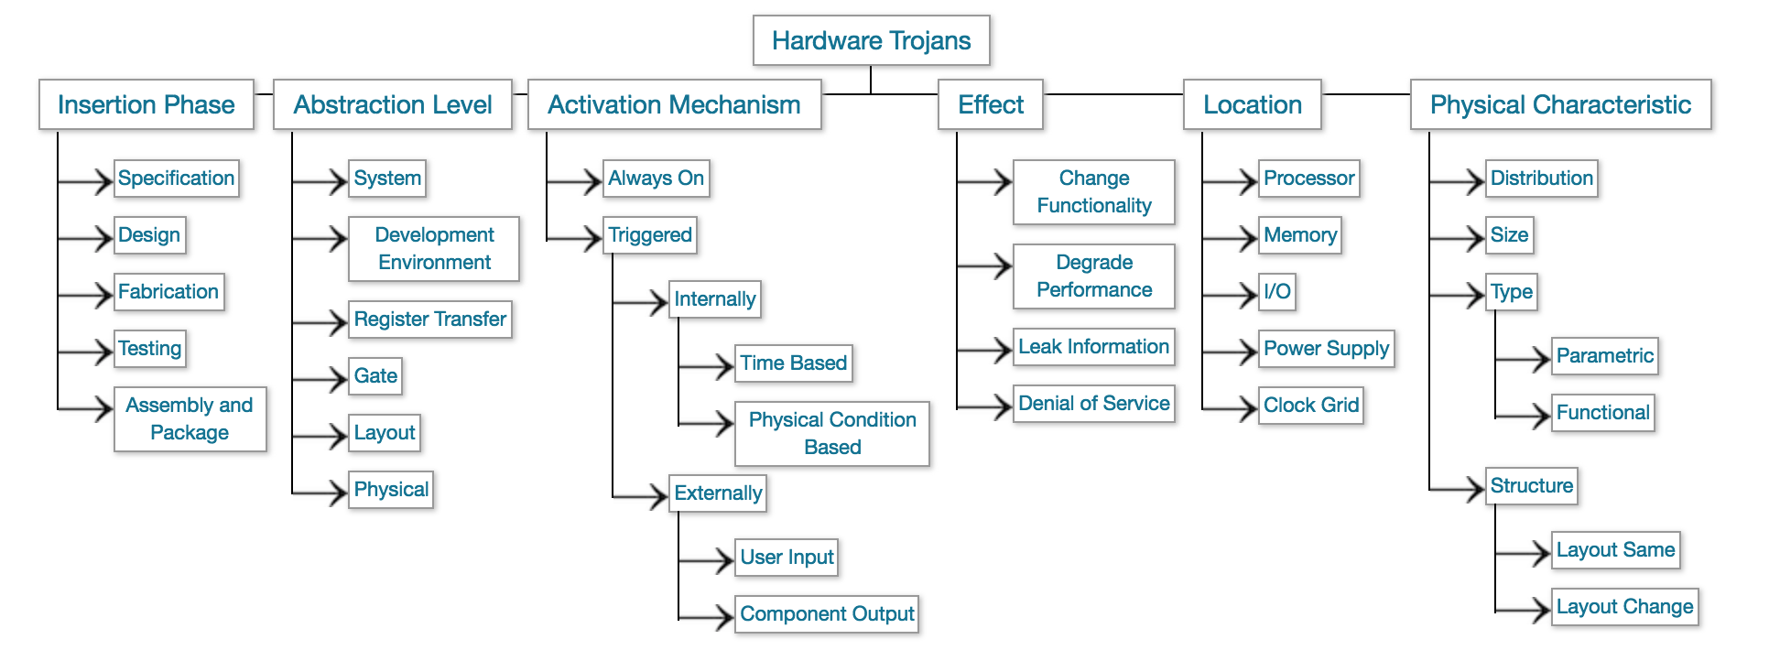
Trojan Taxonomy
20
Notes:
Trojan is decomposed into three principle categories according to their physical, activation and action characteristics.
The physical characteristics of a Trojan are further partitioned into four categories: type, size, distribution, and structure.
This taxonomy describes Trojans using six attributes, including four physical, one activation and one action attribute. Although it is possible for Trojans to be hybrids of this classification, e.g., have more than one activation characteristic, we believe this taxonomy captures the elemental characteristics of Trojans and will be useful for defining the capabilities of various detection strategies.
We will explain them in detail in following slides.

Slide 21
Trojan Taxonomy
Trojan Classification
Physical Characteristics
Activation Characteristics
Action Characteristics
Type
Size
Distribution
Structure
21
Notes:
Trojan is decomposed into three principle categories according to their physical, activation and action characteristics.
The physical characteristics of a Trojan are further partitioned into four categories: type, size, distribution, and structure.
This taxonomy describes Trojans using six attributes, including four physical, one activation and one action attribute. Although it is possible for Trojans to be hybrids of this classification, e.g., have more than one activation characteristic, we believe this taxonomy captures the elemental characteristics of Trojans and will be useful for defining the capabilities of various detection strategies.
We will explain them in detail in following slides.

Slide 22
Examples for Layout Level Trojans
Notes:
As the process of integrated circuits (ICs) shrinks to submicron level, the complexity of and cost of IC fabrication increase significantly. Many IC companies cannot afford to keep upgrading the manufacture process. They just send their design to foundry and let foundry to fabricate and test them. This might be a potential opportunity for attacker to implant Trojans. Additionally, design may use third party IPs. These Trojans may be already inserted in IP cores.

Slide 23
Example: Type
Functional
Parametric
Functional
Addition or deletion of components
Sequential circuits
Combinational circuits
Modification to function or no change
Parametric
Modifications of existing components
Wire: e.g. thinning of wires
Logic: Weakening of a transistor, modification to physical geometry of a gate
Modification to power distribution network
Sabotage reliability or increase the likelihood of a functional or performance failure
23
Notes:
The type category partitions Trojans into functional and parametric classes.
The functional class includes Trojans that are physically realized through the addition or deletion of transistors or gates, while parametric refers to Trojans that are realized through modifications of existing wires and logic. The thinning of a wire, the weakening of a transistor or any modification of a physical geometry designed to sabotage reliability or increase the likelihood of a functional or performance failure are examples of the latter.

Slide 24
Example: Size
Big
Small
Size:
Number of components added to the circuit
Small transistors
Small gates
Large gates
In case of layout, depends on availability of:
Dead spaces
Filler cells
Decap cells
Change in the structure
24
Notes:
The size category accounts for the number of components in the chip that have been added, deleted or compromised.
Size of a Trojan can be an important factor during activation.
Generally speaking, a smaller Trojan has a higher probability for activation than a Trojan with larger number of inputs.

Slide 25
Example: Distribution
Tight
Loose
Tight Distribution
Trojan components are topologically close in the layout
Loose Distribution
Trojan components are dispersed across the layout of a chip
Distribution of Trojans depends on the availability of dead spaces on the layout
Notes:
The distribution category describes the location of the Trojan in the physical layout of the chip. For example, a tight distribution describes a Trojan whose components are topologically close in the layout while a loose distribution describes Trojans that are dispersed across the layout of the chip.
Note that the distribution of Trojans depends on the availability of unused spaces on the layout.
If very small unused spaces are available on the layout, then the adversary may be forced to place and route smaller portions of the Trojan in different unused spaces.
Note that here we assume that the adversary may not change the physical layout dimension of the design.

Slide 26
Example: Structure
No-change
Modified Layout
Change in circuit Form Factor
The adversary may be forced to regenerate the layout to be able to insert the Trojan, then the chip dimensions change
It could result in different placement for some or all the design components
A change in physical layout can change the delay and power characteristics of chip
It is easier to detect the Trojan
26
Notes:
If the adversary is forced to regenerate the layout to be able to insert the Trojan, then the chip dimensions change.
This change could result in different placement for some or all the design components.
Any changes in physical layout can change the delay and power characteristics of chip which will make it easier to detect the Trojan.

Slide 27
Trojan Taxonomy: Activation
Activation Characteristics
Externally-activated
Internally-activated
Receiver/ Antenna
Access Data
Always on
Condition-based
Sensor-based
Logic-based
Temp
Volt
Ext.
Internal state
Input
Cnt/clock
Data
Instruction
Interrupt
27
Notes:
Activation characteristics refer to the criteria that cause the Trojan to become active and carry out its disruptive function.
In order to prevent ‘accidental’ activation and detection during testing phase, attackers will use rare events to activate Trojans.
We partition Trojan activation into two sub-categories, externally-activated and internally-activated.
In externally-activated category, the Trojan can be activated externally by attackers in their time of choosing. This can be done by embedding a receiver and antenna on chip to control it through external signals. This can also be done by accessing the internal registers and forcing them to specific date to extract secret key.
In internally-activated category, Trojan can be always-on or conditional-based. Always-on indicates that the Trojan is always active and it can threat the chip all the time. Conditional-based means the Trojan is triggered under specific conditions, otherwise it will be inactive. In general, there are two ways to trigger it, sensor-based or logic-based. Sensor is usually used to sensor electrical and environmental parameters to activate Trojans. Logic-based uses internal signal or state in the circuits to trigger Trojans.

Slide 28
Activation: Internally Activated
a
e
b
f
j
Internally-activated
c
i
k
d
g
h
Always on
Condition-based
Clk
Counter
Trojan
a
e
b
f
j
c
i
k
d
g
h
Trojan
28
Notes:
This is an example of internally-activated Trojan.
In the top figure, the counter is always on and counts at every clock cycle.
In the bottom figure, AND gate is triggered only when two inputs are 1 to produce 1 at the output. Otherwise, the output is 0.

Slide 29
Trojan Taxonomy: Action
Action Characteristics
Modify Function
Modify Specification
Transmit-information
Add
Bypass
Defects
Reliability
29
Notes:
Action characteristics identify the types of disruptive behavior introduced by the Trojan.
It is classified into three categories: modify-function, modify-specification and transmit information.
They are very straight-forward. They will change functionality, specification of chips and even leak secret information to attackers.

Slide 30

Example: Action
a
e
b
f
j
c
i
k
d
g
h
Modify Function
Trojan
a
e
Modify Specification:
Noise, Delay and Temperature
b
f
j
c
i
k
d
g
h
30
Notes:
This is an example of some actions of Trojans.

Slide 31
IP Trust & IP Security
IP Trust
Detect malicious circuits inserted by IP designers
Goal to Verify Trust: Protect IP buyers, e.g., SoC integrators
Focus of this lecture
IP Security
Information leakage, side-channel leakage, backdoors, functional bugs and flaws, illegal IP use/overuse, etc.
Goal to Verify Security: Protect application
31
Notes:
Before we discuss IP trust issue, we should distinguish IP trust and IP security issue.
IP trust issue is for IP users (buyers). IP security issue is for IP holders (sellers).
In this chapter, we focus on IP trust issue that Trojans may be inserted into netlist or GDSII files.

Slide 32
IP Trust
32
Notes:
How can we trust an IP? How can one establish that the IP does exactly as the specification, nothing less and nothing more?
IP cores from untrusted vendors need to be verified for trust before they are integrated in a system.
Since IP cores have different formats, different methods should be used.
Here are challenges to detect Trojans in IP cores.
There is no golden model for IP core. We have to check its functionality.
We do not know how the layout looks like, if only the HDL is available.
Side-channel signal methods are not working for soft IP.

Slide 33
IP Trust
IPs from untrusted vendors need to be verified for trust before use in a system design
Problem statement: How can one establish that the IP does exactly as the specification, nothing less, nothing more?
IP Cores:
Soft IP, firm IP and hard IP
Challenges:
No known golden model for the IP
Spec could be assumed as golden
Soft IP is just a code so that we cannot read its implementation
33
Notes:
How can we trust an IP? How can one establish that the IP does exactly as the specification, nothing less and nothing more?
IP cores from untrusted vendors need to be verified for trust before they are integrated in a system.
Since IP cores have different formats, different methods should be used.
Here are challenges to detect Trojans in IP cores.
There is no golden model for IP core. We have to check its functionality.
We do not know how the layout looks like, if only the HDL is available.
Side-channel signal methods are not working for soft IP.

Slide 34
Approaches for Pre-synthesis
Formal verification
Property checking
Model checking
Equivalence checking
Coverage analysis
Code coverage
Functional coverage
Notes:
Soft IP is just RTL HDL code. After synthesis, the code will be translated to gate-level netlist.
Formal verification and coverage analysis are used to ensure the netlist can be trusted.
Three types of checking and two types of coverage analysis are described in the following slides.

Slide 35
Formal Verification
Formal verification
Ensuring IP core is exactly same as its specification
Three types of verification methods
Property checking: Every requirement is defined as assertion in testbench and is checked
Equivalence checking: Check the equivalence of RTL code, gate-level netlist and GDSII file
Model checking
System is described in a formal model (C, HDL)
The desired behavior is expressed as a set of properties
The specification is checked against the model
35
Notes:
All functions in the speciﬁcation are deﬁned as properties.
Formal verification is an algorithmic-based approach to logic verification that exhaustively proves functional properties about a design.
Property checking: check whether the IP satisfies these properties.
Equivalence checking: check the equivalence of the RTL code, gate-level netlist, and GDSII file.
Model checking: Some functionalities are described using System Verilog Property and the corresponding assertion is defined simultaneously. We need to ensure IP core satisfies these properties.

Slide 36
Coverage Analysis
Code coverage
Line coverage
Statement Coverage
FSM Coverage
Toggle
Function coverage
Assertion
Show which lines of the RTL have been executed
Spans multiple lines, more precise
Show which state can be reached
Each Signal in gate-level netlist
Successful or Failure
36
Notes:
Coverage metrics include Code Coverage and Functional Coverage.
It has many different types but only a few of them are helpful for IP trust, namely line, statement, toggle, and ﬁnite state machine (FSM) coverage.
Toggle coverage reports whether signals switch in gate-level netlist while the other three coverage metrics show which line(s) and statement(s) are executed, and whether states in FSM are reached in RTL code during veriﬁcation.
All the functional requirements can be translated as different types of assertions. Functional coverage checks those assertions to see whether they are successful
or not.
If all the assertions generated from the speciﬁcation of the 3PIP are successful and all the coverage metrics such as line, statement, and FSM are 100%, then with a high conﬁdence we can assume that the 3PIP is Trojan-free. Otherwise, the uncovered lines, statements, states in FSM, and signals are considered as suspicious. All the suspicious parts constitute our suspicious list.

Slide 37
Suspicious Parts
If one of the assertions fails, the IP is assumed untrusted.
If coverage is not 100%, uncovered parts of the code (RTL, netlist) are assumed suspicious.
37
Notes:
If an IP fails any checking and coverage analysis, it is considered as a Trojan-inserted part.
If the coverage is not 100%, the uncovered parts are still suspicious.

Slide 38
IC Trust
38
Notes:
How can we trust an IP? How can one establish that the IP does exactly as the specification, nothing less and nothing more?
IP cores from untrusted vendors need to be verified for trust before they are integrated in a system.
Since IP cores have different formats, different methods should be used.
Here are challenges to detect Trojans in IP cores.
There is no golden model for IP core. We have to check its functionality.
We do not know how the layout looks like, if only the HDL is available.
Side-channel signal methods are not working for soft IP.

Slide 39
IC (System) Trust
Objective:
Ensure that the fabricated chip/system will carry out only our desired function and nothing more.
Challenges:
Tiny: several gates to millions of gates
Quiet: hard-to-activate (rare event) or triggered itself (time-bomb)
Hard to model: human intelligence
Conventional test and validation
approaches fail to reliably detect
hardware Trojans.
Focus on manufacture defects and
does not target detection of additional
functionality in a design
Notes:
IC trust issue is that Trojans might be inserted during fabrication phase. The objective is to ensure that the fabricated chip/system will carry out only our desired function and nothing more. Detecting Trojans in these fabricated chips is very challenging due to the following reasons:
Tiny: Comparing to original design, Trojan’s size is much smaller.
Dormant: Some Trojans do not create failure and just leak secret information. Some Trojans are only working under rare condition. In most time, the chip is working same as genuine chip. It is very difficult for us to find out whether it contains Trojan.
Hard to model: Trojan is intentionally designed and inserted by human beings. Manufacture defects can be modeled, but Trojan is hard to model. Smart attacker will change their design out of expectation.
Tradition test and validation methods fail, because they are based on the defect model.

Slide 40
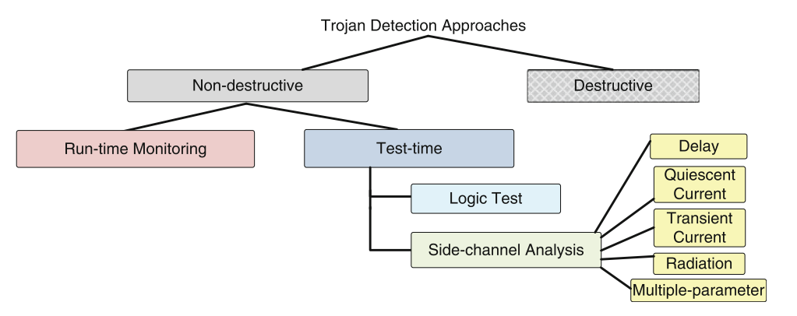
Classification of Trojan Detection Approaches
Destructive Approach: Expensive and time consuming
Reverse engineering to extract layer-by-layer images by using delayering and Scanning Electron Microscope
Identify transistors, gates and routing elements by using a template-matching approach – needs golden IC/layout
Notes:
The overall taxonomy of Trojan detection approaches is shown. They can be broadly classified into destructive and non-destructive approaches.
Basically, the destructive approach is doing reverse engineering and comparing it with the golden design. If any modification is found, it could be a Trojan-inserted chip. Since the chip is destroyed after destructive inspection, chips need to be sampled and we cannot ensure rest of chips are Trojan-free.
Non-destructive approach will not damage the chip under test.

Slide 41
Classification of Trojan Detection Approaches
Non-destructive Approach
Run-time monitoring: Monitor abnormal behavior during run-time
Exploit pre-existing redundancy in the circuit
Compare results and select a trusted part to avoid an infected part of the circuit.
Test-time Authentication: Detect Trojans throughout test duration.
Logic-testing-based approaches
Side-channel analysis-based approaches
Notes:
The non-destructive technique can be classified into run-time monitoring and test-time.
Run-time monitoring does not need any extra testing time. Untrusted components might be integrated in the system. Redundant components are added to ensure trust of critical computations. The system can disable the chip upon detection of malicious logic or bypass it to allow reliable operations.
On the other hand, test-time means that we need to spend extra testing time on Trojan detection.
Only trusted ICs are picked to integrated into system.
Functional and structural testing are used to activate the Trojan and observe faulty logical results from outputs.
Extra gates induced by Trojans also can impact side-channel signals, such as delay, leakage current, transient current and radiation.
By comparing side-channel signals, Trojan-inserted chips could be identified.

Slide 42
Hardware Trojan Benchmarks
A set of trust benchmarks for researchers in academia, industry, and government is needed to
Provide a baseline for examining diverse methods developed
Establishing a sound basis for the hardness of each benchmark instance
Help increase reproducibility of results by others who intend to employ certain methodologies in their design flow
See NSF supported Trust-Hub website (www.trust-hub.org)
Complete taxonomy of Trojans
More than 120 trust benchmarks available which were designed at different abstraction levels, triggered in several ways, and have different effect mechanisms
More than 300 publications used these benchmarks
Notes:
Before we discuss methods for detecting and/or preventing Trojan insertion, we’ll conclude this background portion of the slides with a brief discussion of benchmarks and their importance.
We are all familiar with benchmarks. In the scope of the performance analysis of computer systems, we define benchmarking
as the act of measuring and evaluating computational performance (hardware and/or software), under reference conditions, relative to a reference evaluation. The goal of this benchmarking process is to enable fair comparison between different solutions, or between subsequent developments.
Now you’ve seen all the classes of Trojan attacks and characteristics possible ranging from physical to activation to action. It should be clear that there’s no silver bullet solution to detect and avoid them, but there was also an even greater issue: evaluation. A multitude of approaches and methodologies were being developed by researchers in academia and industry to deal with hardware Trojans and other problems, but the effectiveness of these methods were not universally accepted and maybe applicable to some designs, some platforms, some technologies but not to others.
So Prof. Tehranipoor brought together a bunch of leaders in the community to develop a resource to provide the community with a forum to exchange ideas, benchmark circuits, platforms, tools, and resources. The resource is website called Trust-hub.org and it hosts various resources which will help you learn about your science area, including online presentations, courses, learning modules, animations, teaching materials, and more. It also includes information about community activities such as technical events, workshops, seminars, and news stories.
With respect to Trojans, Trust-HUB provides more than 80 Trojan benchmarks (free to the public) which vary based on point of insertion, activation characteristics, actions, etc. This provides a much needed baseline for examining various methods developed by researchers in academia and industry, establishing a sound basis for the hardness of each design instance, and providing common platforms that can enable effective implementation of methodologies and allow for repeatabilty of experiments.
If you are interested in performing research in this area, we strongly encourage you to have a look have a look at the benchmarks available on trust-hub, to use them in your research, and to develop your own benchmarks and submit them for use in the community as well.

Slide 43
Logic Testing Approach
Logic-testing approach focuses on test-vector generation for
Activating a Trojan circuit
Observing its malicious effect on the payload at the primary outputs
Both functional and structural test vectors are applicable.
Pros & Cons:
Pros:
Straight-forward and easy to differentiate
Cons:
The difficulty in exciting or observing low controllability or low observability nodes.
Intentionally inserted Trojans are triggered under rare conditions.
(e.g., sequential Trojans)
It cannot trigger Trojans that are activated externally and can only observe functional Trojans.
Notes:
Logic-testing approach is a very straight-forward. We try to trigger the Trojan and see what happens.
The difficulty is how to activate Trojan and observe its effect. We know many nets in complex design are hard-to-reach or hard-to-observe.
In order to hide Trojans’ effect, we can expect that Trojans can only be triggered under very rare conditions.
For some Trojans which are activated externally or transmitting information by antenna, this method fails to detect them.
#Stuck-at-fault: manufacturing defects are typically modeled as stuck-at-faults where an internal node is stuck at a particular logic value.

Slide 44
Functional Test Deficiency
Functional patterns could potentially detect a “functional” Trojan.
Exhaustive test would be effective, but certainly not applicable for large circuits
E.g. 64 input adder → 2⁶⁵ input combination (including carry in)
2⁶⁵ > 10¹⁸ – This is impractical
100MHz is used → 10¹⁰ s → 317 years
Only a few and more effective patterns are used → Trojan can escape.
The fault coverage is low for manufacturing test
In practice, structural tests are used.
Notes:
Exhaustively testing functions by using functional patterns is not practical.
Structure tests are used.

Slide 45
Functional Testing
Feasible Trojan space inordinately large!
Deterministic test generation infeasible
A statistical approach is, more effective
MERO: A Statistical Approach
Find the rare events in the circuit
Generate vectors to trigger each rare node N times
Provides high confidence in detecting unknown Trojans!
a
Trojan Trigger Condition
a=0, b=1, c=1
b
c
From original circuit
Chakraborty et al, CHES 2009

Slide 46
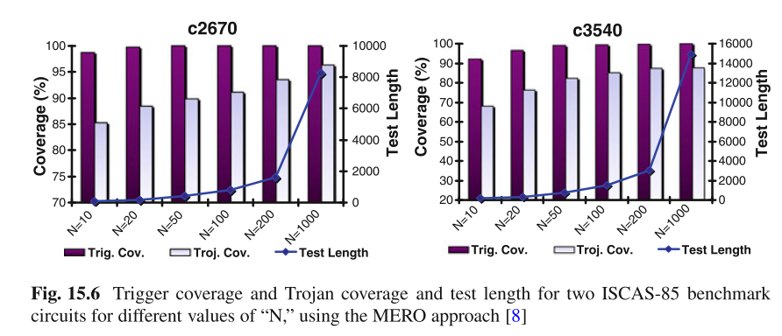
MERO
MERO:
Generates a set of test vectors that can trigger each rare node to its rare value multiple times (N times)
It improves the probability of triggering a Trojan activated by a rare combination of a selection of the nodes
Challenge: Triggering each net N times in a large circuit is challenging
Notes:
One-time trigger cannot ensure the Trojan will be activated.
A new test vector generation technique was proposed to increase the test coverage.
It is still effective for sequential Trojans.
The Trojan detection coverage increases for higher values of “N”, at the cost of increased test length.

Slide 47
Comprehensive Attack Model
47
Notes:
How can we trust an IP? How can one establish that the IP does exactly as the specification, nothing less and nothing more?
IP cores from untrusted vendors need to be verified for trust before they are integrated in a system.
Since IP cores have different formats, different methods should be used.
Here are challenges to detect Trojans in IP cores.
There is no golden model for IP core. We have to check its functionality.
We do not know how the layout looks like, if only the HDL is available.
Side-channel signal methods are not working for soft IP.

Slide 48

Side Channel Signal Analysis -- Power
Hardware Trojans inserted in a chip can change the power consumption characteristics.
Partial activation of Trojan can be extremely valuable for power analysis.
The more number of cells in Trojan is activated the more the Trojan will draw current from power grid.
Trojan
1
Partial Activation
1
1
Golden chip required!
Notes:
An example of IDDT (transient current) Trojan detection method is presented.
Extra transient current is induced by Trojan with partial activation.
More switchings in Trojan can draw more current and make Trojan detection easier.

Slide 49
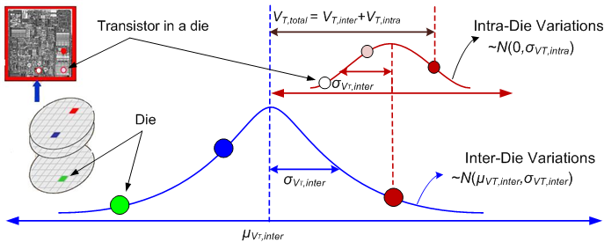
Side-Channel Trojan Detection
Side-Channel Approach for Trojan Detection relies on observing Trojan effect in physical side-channel parameter, such as switching current, leakage current, path delay, electromagnetic (EM) emission
Due to process variations, it is extremely challenging to detect the Trojan by considering F_{max} or I_{DDT} individually.

Slide 50
Side-channel Signals
All the side-channel analyses are based on observing the effect of an inserted Trojan on a physical parameter such as
IDDQ: Extra gates will consume leakage power.
IDDT: Extra switching activities will consume more dynamic power.
Path Delay: Additional gates and capacitance will increase path delay.
EM: Electromagnetic radiation due to switching activity
Pros & Cons
Pros: It is effective for Trojan which does not cause observable malfunction in the circuits.
Cons: Large process variations in modern nanometer technologies and measurement noise can mask the effect of the Trojan circuits, especially for small Trojan.
Golden chip required!
Notes:
Additional gates induced by Trojans will impact some physical parameters, such as IDDQ, DDT, delay and EM.
Full Trojan activation is not required. For power and EM, partial activation is needed. For path delay, activation is not required, because gates and capacitance are already added on a path.
Process variation might mask Trojan’s effect. Existing side-channel approaches tend to perform process calibration by using normalization (or process-corner estimation) and measurement noise calibration by averaging over multiple measurements to get rid of random noise.
In order to get rid of inter-die variations and calibrate systematic intra-die variations, region-based approaches are used where measurements from multiple power pins corresponding to activation of distinct regions, help to compare the measured parameter from the same IC under different circumstances.
Statistical signal processing techniques can be used to calibrate the process noise and reduce the measured side-channel parameter to be close to the nominal value, for all ICs.

Slide 51
Sensitivity Metric
Improving Detection Sensitivity
Trojan Size
Sensitivity
Circuit Size
Sensitivity

Slide 52
Comparing Approaches
 | Logic Testing | Side-Channel Analysis
Pros | Robust under process noise Effective for ultra-small Trojans | Effective for large Trojans Easy to generate test vectors
Cons | Difficult to generate test vectors Large Trojan detection challenging | Vulnerable to process noise Ultra-small Trojan Det. challenging
A combination of logic testing & side-channel analysis could provide the good coverage!
Online validation approaches can potentially provide a second layer of defense!

Slide 53
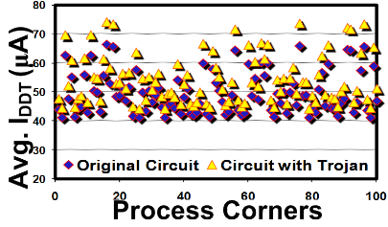
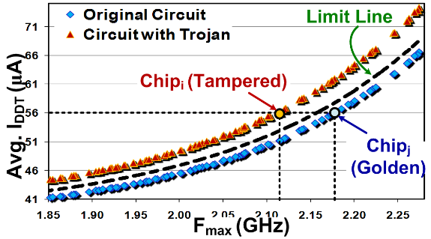
Side-channel Approach
Multiple-parameter Trojan Detection
Due to process variations, Trojan detection by F_{max} or I_{DDT} alone is challenging!
Consider the intrinsic relationship between I_{DDT} and F_{max}
Golden chip required!
Notes:
53

Slide 54
Trojan Inserted into s38417 Benchmark
PP1
PP2
3-Bit Counter
PP3
PP4
PP: Power Pad
Notes:
RC model is used to simulate the power distribution network.
High switchings at one location will draw more current from power pad nearby.

Slide 55
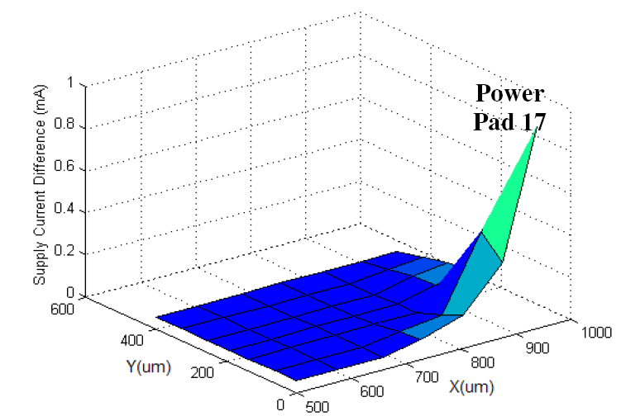
Power Analysis -- Locality
Current difference measured from power pad 17 (Trojan-free vs Trojan-inserted)
There is no change in layout of the circuit. Trojan was inserted in an unused space in the circuit layout.
Notes:
Supply current difference between a Trojan-inserted chip and a Trojan-free chip can indicate the exsitence and location of Trojans.

Slide 56



Current (Charge) Integration Method
Current consumption of Trojan-free and Trojan-inserted circuits
Trojan inserted
Trojan free
Current Monitor
Current
Integration
Die under authentication
ΔQ
Golden Die
Notes:
Current integration is used to differentiate Trojan-free and Trojan-inserted ICs.

Slide 57
Power Analysis -- Challenges
Pattern Generation
How to increase switching activity in Trojans?
How to reduce background noise?
Switching locality
Random Patterns
No observation is necessary , Similar to test-per-clock
Measurement Device Accuracy
Measurement noise
Process Variations
Calibration
On-Chip Measurement
Vulnerable to attack
Authentication Time
Trojans can be inserted randomly

Slide 58






Side Channel Analysis -- Delay
Hard to detect using power analysis are:
Distributed Trojans
Hard-to-activate Trojans
Path delay: A change in physical dimension of the wires and transistors can also change path delay.
We are developing new methods that can detect additional delays on each path of the circuit.
Trojan
Notes:
Some types of Trojan, such as distributed Trojan, are hard to be detected by using power.
Additional capacitances or gates from Trojans will increase path delay.

Slide 59
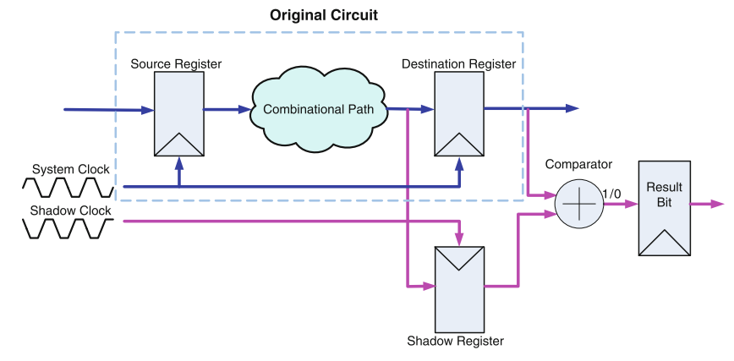
Delay-based Methods
Shadow-register provides a possible solution for measuring internal path delay.
From this architecture, it can be seen that the basic unit contains one shadow register, one comparator and one result register.
Limitations:
PV
Overhead
S-clock
Output
Notes:
The shadow register is located in parallel with the destination register at which a path ends. Different from the system clock, shadow registers are controlled by a negative-skewed clock signal the shadow clock. The frequency and phase of the system clock are kept constant in order to maintain the functionality of the original circuit even when in delay testing mode. The shadow clock has the same frequency as the system clock but its phase is adjustable.
Limitation:
Need to a very accurate clock signal
High overhead
PV can easily deteriorate this method.

Slide 60
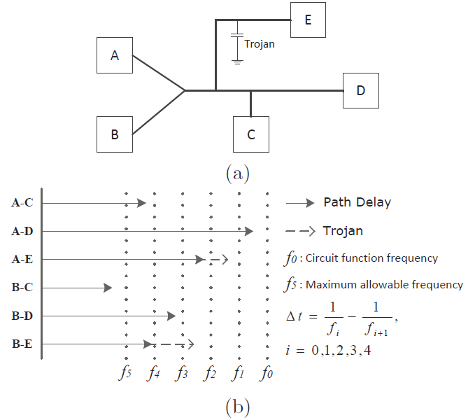
Clock Sweeping Technique
Clock sweeping involves applying a pattern at different clock frequencies, from a lower speed to higher speeds.
Some paths sensitized by the pattern which are longer than the current period start to fail when the clock speed increases.
The obtained start-to-fail clock frequency can indicate the delays of the paths sensitized by the patterns
Notes:
To detect the small delay change caused by Trojan, clock sweeping technique is proposed.
It uses different clock frequencies to measure length of path.

Slide 61
Delay Analysis -- Challenges
Major advantage over power analysis: No activation is required.
Detection and Isolation
How significant is the delay inserted by Trojan?
It depends on Trojan size and type
Location: on short paths or long paths
Pattern Generation
Delay test patterns
Path Coverage
Process Variations (V_{th}, L, T_{ox})
Impact circuit delay characteristics significantly
Differentiate between Trojan and PV
Trojan can have impact on multiple paths (an advantage over PV)

Slide 62
Trojan Detection
Trojan |  |  |  | Power Analysis | Delay Analysis | Fully Activation
Trojan Classification | Physical Characteristics | Type | Functional | D | P | P
 |  |  | Parametric | P | D | P
 |  | Size | Small |  | D | P
 |  |  | Large | D | P | P
 |  | Distribution | Tight | D | D | P
 |  |  | Loose | P | D | P
 |  | Structure | Modify Layout | P | D
 | Activation Characteristics | Always-on |  |  | D
 |  | Condition-based | Logic-based | D | P | P
 |  |  | Sensor-based | D
 | Action Characteristics | Modify Function |  | D | P
 |  | Modify Spec. | Defects | P | D | P
 |  |  | Reliability | P | P | P
P: Detection is possible D: High level of confidence

Slide 63
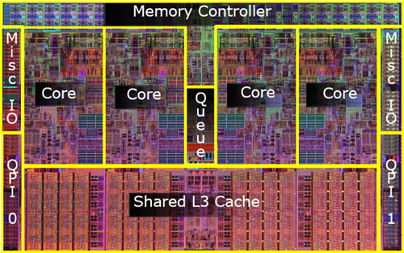
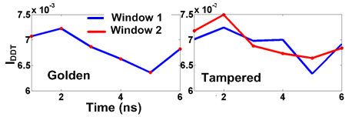
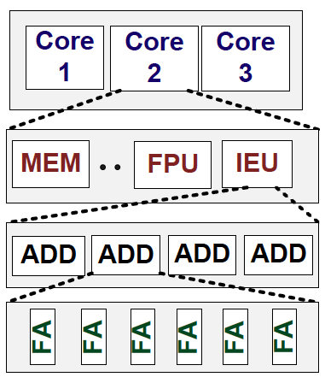
Self-similarity in Space & Time – for Trust Verification
Image courtesy: Intel
Uncorrelated switching in time due to a seq. Trojan!
Simultaneously detects Trojan & aged/recycled ICs!
ALU
ALU
No golden chip required!!!

Slide 64
Design for Hardware Trust
Since detecting Trojan is extremely challenging, design for hardware trust approaches are proposed to
Improve hardware Trojan detection methods
Improve sensitive to power and delay
Rare event removal
Prevent hardware Trojan insertion
Design obfuscation
Notes:
Detecting such a low-overhead and quiet Trojan is extremely challenging, so some design for hardware trust methods are proposed to change the design for facilitating Trojan detection and preventing Trojan insertion.
Hard-to-activated Trojans are not easy to be detected by using either full activation methods or side-channel signal methods.
Some techniques can improve sensitive to power and delay or remove low controllability/observability nets in the design.
Other techniques can make adversary difficult to insert hardware Trojans.

Slide 65
Rare Event Removal
Intelligent attackers will choose low-frequency events to trigger the inserted Trojans.
Improving controllability or observability can make rare events scarce, thereby facilitating detecting Trojans inside the design.
Design for Trojan test: inserting probing points
Inserting dummy scan ﬂip-ﬂops

Slide 66
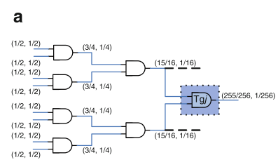
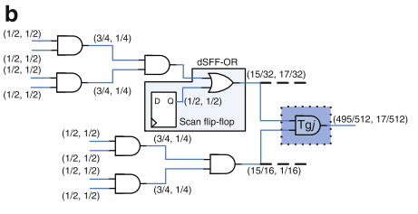
Increasing Probability of Partial/Full Activation
Inserting dummy FFs on path with very low activation probability
Notes:
To increase transition probability of nets whose transition probability is lower than a sepcific probability threshold, some efficient dummy flip-flops are inserted at these nets.
In the figure, for each net the first value is probability of “0” and the second value is probability of “1”.
In figure a, the transition probability of Trojan gate is low because of low transition probability on two inputs.
If one dummy filp-flop is inserted at the first input in figure b, the transition probability of Trojan gate increases, so that it can be activated easier.

Slide 67
Increasing Probability of Partial/Full Activation
Dummy scan flip-flops are inserted to control hard-to-excite nodes.
Usage:
Full activation: increase controllability
Power-based: generate switching activities
Delay-based: activate more paths to improve coverage
Notes:
Dummy flip-flops insertion technique is useful in full activation, power-based, and delay-based hardware Trojan detection methods.

Slide 68
Trojan Prevention-Design obfuscation
The objective is deterring attackers from inserting Trojans inside the design.
Design obfuscation means that a design will be transformed to another one which is functionally equivalent to the original, but in which it is much harder for attackers to obtain complete understanding of the internal logic, making reverse engineering much more difﬁcult to perform.
It obfuscates the state transition function to add an obfuscated mode on top of the original functionality (called normal mode).
Notes:
Design obfuscation means that a design will be transformed to another one which is functionally equivalent to the original, but in which it is much harder for attackers to obtain complete understanding of the internal logic, making reverse engineering much more difﬁcult to perform.
The authors propose a Trojan prevention method that obfuscates the state transition function to add an obfuscated mode on top of the original functionality (called normal mode).

Slide 69
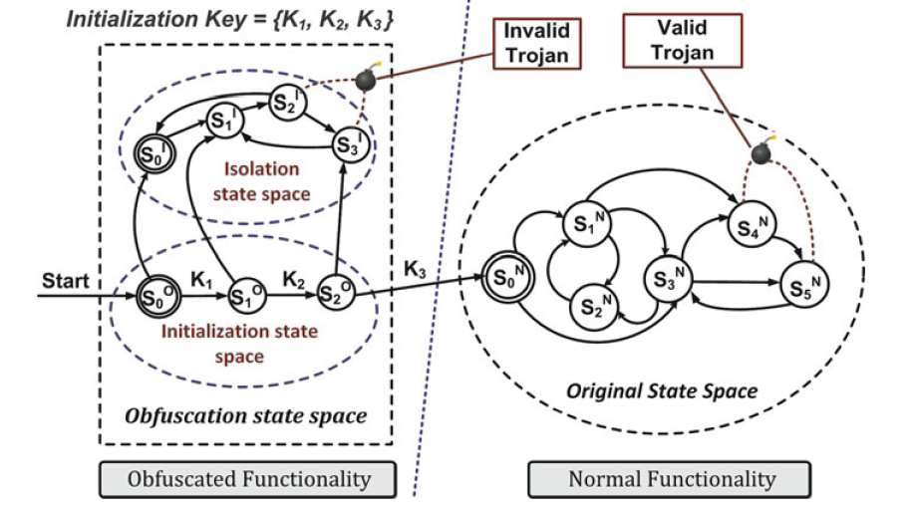
Design obfuscation
Specified pattern is able to guide the circuit into its normal mode.
The transition arc K3 is the only way the design can enter normal operation mode from the obfuscated mode.
Notes:
Designer adds obfuscated functionality in front of normal functionality.
Only designer knows the specified pattern (initialization key) to access normal function.
If a Trojan is inserted in the obfuscated circuits, it will not affect the original functionality. This is an invalid Trojan in the figure.
If a Trojan is inserted in the original circuits, it will threaten the original circuits.

Slide 70
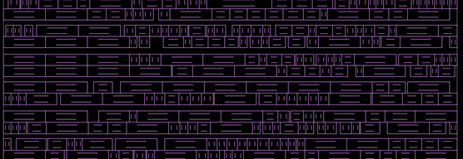
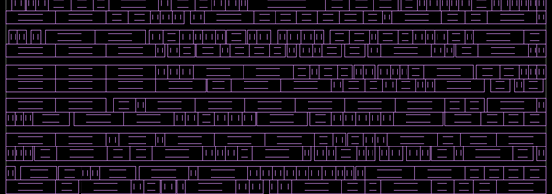
BISA: Built-In Self-Authentication
Filling all unused spaces with a circuit that can easily test itself

Slide 71

Question?

